Slide 1
Reverse Scaffolding and Test Case–Driven Learning
Dr M Janaki Meena

Slide 2
Reverse-Engineer the Problem
Learners are given executable examples consisting of specific inputs and expected outputs.
This provides a concrete foundation for understanding behavior before formal specifications are defined.

Slide 3
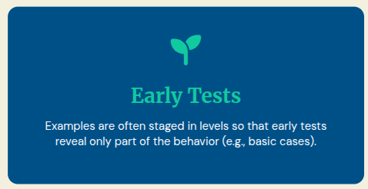
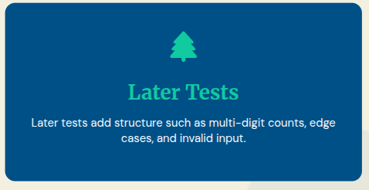
Staged Levels

Slide 4
Inductive Inference
Learners must inductively infer a precise specification, write it in their own words, then implement something that satisfies all levels.
This process shifts the focus from following instructions to active pattern recognition and mental model construction.

Slide 5
Teaching Pedagogy - Inquiry-Based Learning
Learners build mental models by observing patterns in examples rather than memorizing a definition.
They must reconcile contradictions when a new level of tests “breaks” their first guess, which mirrors how real requirements evolve.

Slide 6
Scaffolding
Leveled tests are deliberate scaffolds: each level stays within the learner’s zone of proximal development.
Early levels make success likely; later levels push abstraction (e.g., from single-digit to multi-digit counts).

Slide 7
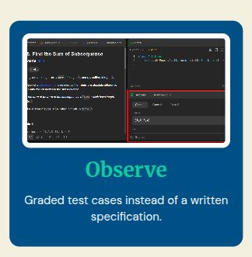
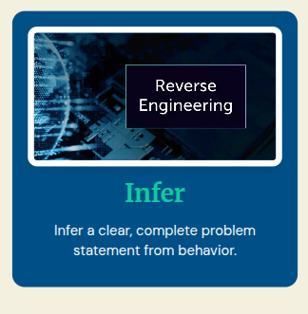

The Learning Path

Slide 8
Mirroring Real Software
This mirrors how real software is often specified—through examples and evolving constraints—and strengthens both precise reasoning and test-driven habits.

Slide 9
Fundamental
Give an arithmetic expression and the resultant value - Ask students to determine the precedence and associativity

Slide 10
Problem 1
You are designing a system that processes event logs generated by two sensors in a factory. Based on the given test cases, identify the policy used to process and combine these logs.

Slide 11
Problem 1
Test case 1
[3,1], [7,4]
[1,3,4,7]

Slide 12
Problem 1
Test case 2
[4,1], [7,4]
[1, 4, 7]

Slide 13
Problem 1
Test case 3
[4,2], [2,4]
[2,4]

Slide 14
Problem 1
Test case 4
[4,2,1], [7,4,5]
[1, 2, 4, 5, 7]

Slide 15
Problem 1
Test case 5
[3,1], [7,2]
[1,2,3,7]

Slide 16
Problem 2
The company has imposed some additional constraints on the logs recieved. This is how the new system works

Slide 17
Problem 2
Test case 1
[3,1], [7,4]
[1,3,4,7]

Slide 18
Problem 2
Test case 2
[4,1], [7,4]
[1, 4, 7]

Slide 19
Problem 2
Test case 3
[4,2], [2,4]
[2,4]

Slide 20
Problem 2
Test case 4
[4,2,1], [7,4,5]
[1, 2, 4, 5, 7]

Slide 21
Problem 2
Test case 5
[3,1], [7,2]
Invalid

Slide 22
Problem 1
Problem 2
TC1 - >[3,1], [7,4]
OP -> [1,3,4,7]
TC2 -> [4,1], [7,4]
OP -> [1, 4, 7]
TC3 -> [4,2], [2,4]
OP -> [2,4]
TC4 -> [4,2,1], [7,4,5]
OP -> [1, 2, 4, 5, 7]
TC5->[3,1], [7,2]
OP -> [1,2,3,7]
TC1 - >[3,1], [7,4]
OP -> [1,3,4,7]
TC2 -> [4,1], [7,4]
OP -> [1, 4, 7]
TC3 -> [4,2], [2,4]
OP -> [2,4]
TC4 -> [4,2,1], [7,4,5]
OP -> [1, 2, 4, 5, 7]
TC5->[3,1], [7,2]
OP -> Invalid

Slide 23
Define the Problem from the Procedure
Students reconstruct the task and the governing rules from a given step-by-step solution, then justify and implement

Slide 24
Solution Steps of the Problem
Given array of elements : [2, -4, 6, -1, 3, -2]
Step 1: Start with first element (2)
current_start_index=1
current_end_index=1
current_sum = 2
best_sum = 2
best_start_index = 1
best_end_index = 1

Slide 25
Solution Steps of the Problem
Given array of elements : [2, -4, 6, -1, 3, -2]
Step 2: Next element (-4):
current_start_index=1
current_end_index=2
current_sum = 2+(-4)
best_sum = 2
best_start_index = 1
best_end_index = 1

Slide 26
Solution Steps of the Problem
Given array of elements : [2, -4, 6, -1, 3, -2]
Step 3: Next element (6):
current_start_index=3
current_end_index=3
current_sum = 6
best_sum = 6
best_start_index = 3
best_end_index = 3

Slide 27
Solution Steps of the Problem
Given array of elements : [2, -4, 6, -1, 3, -2]
Step 4: Next element (-1):
current_start_index=3
current_end_index=4
current_sum = 5
best_sum = 6
best_start_index = 3
best_end_index = 3

Slide 28
Solution Steps of the Problem
Given array of elements : [2, -4, 6, -1, 3, -2]
Step 5: Next element (3):
current_start_index=3
current_end_index=5
current_sum = 8
best_sum = 8
best_start_index = 3
best_end_index = 5

Slide 29
Solution Steps of the Problem
Given array of elements : [2, -4, 6, -1, 3, -2]
Step 6: Next element (-2):
current_start_index=3
current_end_index=6
current_sum = 6
best_sum = 8
best_start_index = 3
best_end_index = 5

Slide 30
Solution Steps of the Problem
Output
best_sum = 8, best_start_index = 3, best_end_index = 5

Slide 31
Inquiry-based learning
Trains students to reverse-engineer the thinking process behind a solution, not just apply it
Learners should ask themselves:
What is being optimized?
What variables change between steps
What rules connect the steps?

Slide 32
Inquiry-based learning
Students move from “What is the answer?” to “How does the system think?”
They build deeper understanding and transferable problem-solving skills

Slide 33
Reverse Scaffolding (Definition-Last)
In traditional teaching: We give the problem definition, then the algorithm, then students trace examples.
In reverse scaffolding: Students first see the steps or execution, and only later arrive at the definition themselves.

Slide 34
Reverse Scaffolding (Definition-Last)
When students see only the step-by-step process:
They are forced to think: “What is happening here?”
They try to infer the rule instead of recalling a memorized one
This builds a mental model, not just memory

Slide 35
Normalization
You are developing a system that collects readings from industrial sensors in a factory. Before storing or analyzing the data, the system automatically normalizes the sensor values. Given the original sensor readings and the transformed (normalized) values produced by the system, determine the normalization technique used and code it

Slide 36
Normalization
Original Data: [20, 40, 60, 80]
Transformed Data: [0, 0.33, 0.67, 1]

Slide 37
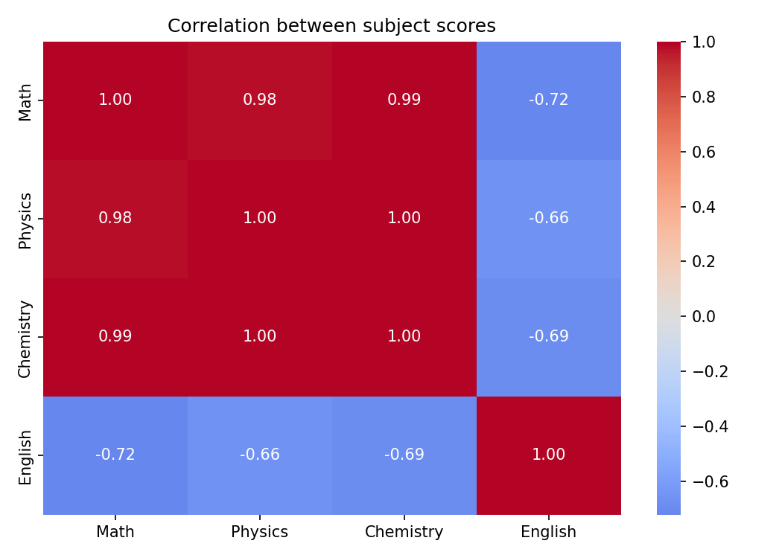
Find Missing Data using Heat Map

Slide 38
Find Missing Data using Heat Map
Student | Math | Physics | Chemistry | English
S1 | 50 | ? | 51 | ?
S2 | 60 | 62 | ? | ?
S3 | 70 | ? | 71 | ?
S4 | 80 | 82 | ? | ?
S5 | 90 | ? | 91 | ?

Slide 39
Step 1: Read the Heatmap Carefully
Math–Physics ≈ 0.98 → very strong positive
Math–Chemistry ≈ 0.99 → very strong positive
Physics–Chemistry ≈ 1.00 → almost perfect
Math–English ≈ -0.72
Physics–English ≈ -0.66
Chemistry–English ≈ -0.69
English must decrease as others increase

Slide 40
Observe Given Data Pattern
Math: 50, 60, 70, 80, 90 (strictly increasing)
Physics: ?, 62, ?, 82, ?
Chemistry: 51, ?, 71, ?, 91
Chemistry ≈ Math + 1 (based on given values 51, 71)
Physics ≈ Math + 2 (based on given values 62, 82)

Slide 41
Step 3: Fill Physics Values
S1: 50 → 52
S3: 70 → 72
S5: 90 → 92

Slide 42
Step 4: Fill Chemistry Values
Chemistry ≈ Math + 1
S2: 60 → 61
S4: 80 → 81

Slide 43
Step 5: Decide English Trend
From heatmap: Strong negative correlation
As Math increases → English must decrease

Slide 44
Step 6: Assign English Values
Choose a monotonic decreasing sequence
Example:
90, 80, 70, 60, 50

Slide 45
Students will Learn
Correlation is a trend, not exact value
Identify linear relationships
Maintain consistency across rows
Use monotonic increase/decrease
Ensure relationships match heatmap
Note: No single answer for the problems

Slide 46
Problem 2 - Wrong Value
Student Math Physics Chemistry English
S1 50 52 51 90
S2 60 62 61 85
S3 70 72 71 88 ❌
S4 80 82 81 60
S5 90 92 91 50
Identify the incorrect value
Fix it so correlations are preserved

Slide 47
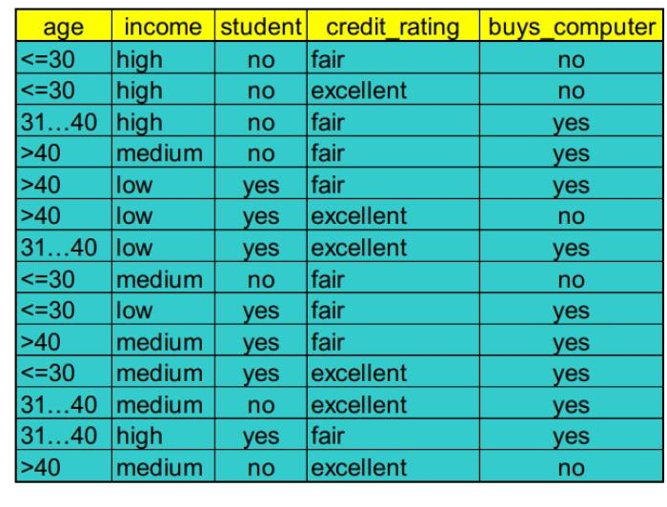
Sample Data to Construct Decision Tree

Slide 48
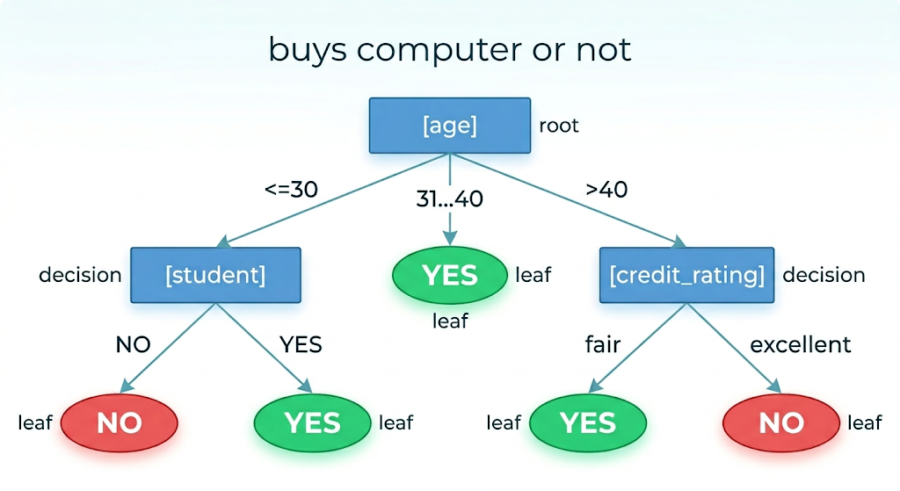
Find Sample Data from the Decision Tree

Slide 49
Find Sample Data from the Decision Tree
ID | age | income | student | credit_rating | buys_computer
1 | <=30 | high | no | fair | no
2 | <=30 | low | yes | excellent | yes
3 | 31...40 | low | no | fair | yes
4 | >40 | low | yes | fair | yes
5 | >40 | high | no | excellent | no
Income is inserted in such a way that the decision is yes for low income and no for high income which shall be given as part of the problem

Slide 50
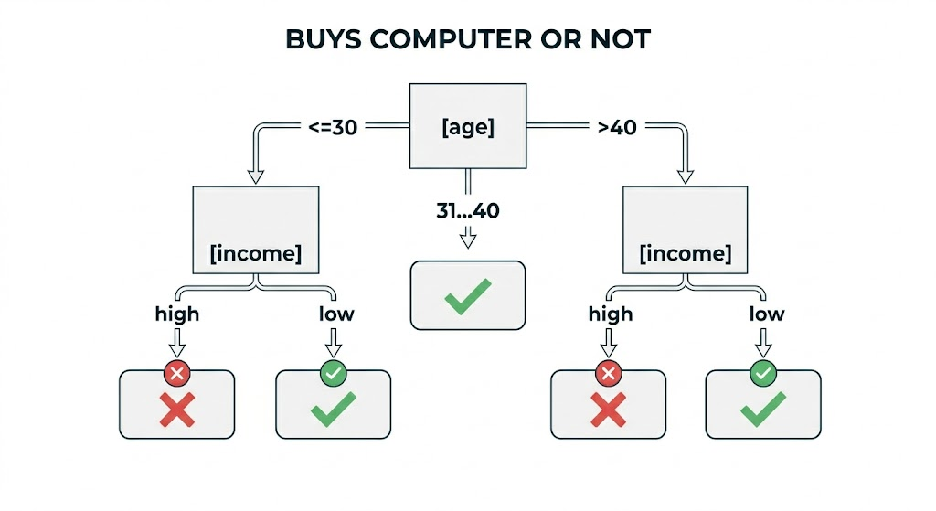
Modified Decision Tree

Slide 51
